Slide 1

Bank of Baroda Hackathon 2024
Team Name: AI for good
AI for Good: Using artificial intelligence to make the world a better place.
Date:29/6/2024

Slide 2

Financial Advisory Chat bot
To revolutionize financial advisory services using generative AI to provide personalized, data-driven financial advice to customers.

Slide 3

Vision for the Future
I see immense potential in revolutionizing financial advisory services with AI, creating a more financially literate and empowered society. Addressing the critical need for accessible and understandable financial advice, with the Indian financial literacy rate at just 27%, I aim to leverage my AI expertise to develop simple, effective solutions that make financial advisory more personalized, adaptive, and transparent.
Enhancing financial literacy and advisory services can significantly boost the Indian economy by enabling better financial decisions. My goal is to create a future where everyone has access to the knowledge and tools needed to make informed financial decisions, driving both personal and national economic growth.

Slide 4





Why Our Solution is Better & Adoption Strategy
Personalization
Uses advanced AI to provide tailored financial advice based on individual data, offering a truly personalized experience.
Real-Time Adaptability
Offers real-time adjustments to advice as financial conditions and goals change, ensuring the guidance remains relevant.
Transparency
Ensures transparent and explainable AI processes, building user trust in the recommendations provided.
Comprehensive Service
Combines investment advice, financial planning, and education in one convenient platform, addressing all financial needs.
Ease of Use
Provides a user-friendly interface accessible via web and mobile platforms, making financial advisory accessible to all.

Slide 5
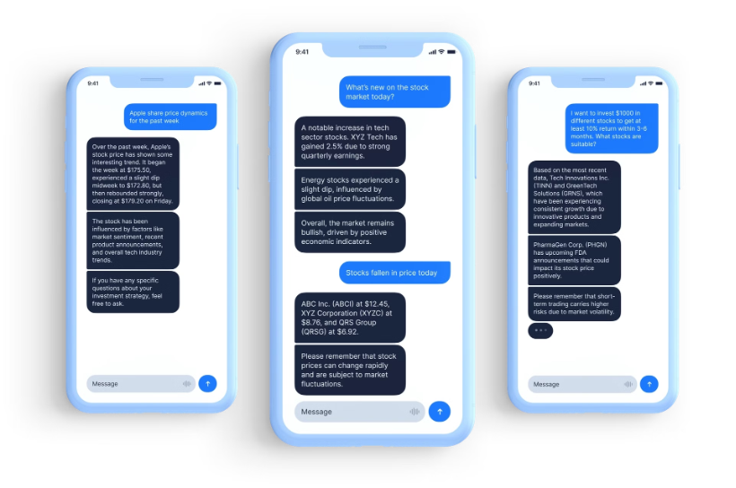
How far it can go?
The potential of our financial advisory chatbot is truly boundless. By leveraging the power of AI and machine learning, we can continuously expand its capabilities, offering increasingly personalized and comprehensive financial guidance to users.
As the chatbot interacts with more users and gathers more data, its understanding of individual financial needs and market trends will deepen, allowing it to provide even more tailored and insightful advice. Additionally, integrating new data sources and technologies will enable the chatbot to tackle more complex financial scenarios and offer a wider range of services.

Slide 6
Business Applications of the Financial Advisory Chatbot
Personal Finance Guidance
Investment Advice
User Engagement and Retention
Scalability and Accessibility
The chatbot advises on strategies to rapidly accumulate savings and achieve financial independence. It can also calculate retirement savings goals and timelines based on user inputs.
The chatbot provides personalized advice on budgeting, saving, and managing debt. It offers strategies to help users achieve financial stability and independence.
The chatbot enhances user engagement through interactive and personalized financial planning sessions. It builds trust and loyalty by providing reliable and actionable financial advice.
The chatbot is designed to scale and handle a large volume of users simultaneously. It provides 24/7 accessibility to financial advice, catering to global audiences.

Slide 7
Presenting the Solution: Financial Advisory Chatbot
Methodology:
Data Collection: Gather customer financial data and market trends.
Model Training: Use Azure Machine Learning to develop personalized advice algorithms.
Chatbot Development: Implement using Azure Bot Service and Azure Cognitive Services for NLP.
Deployment: Host on Azure App Service with serverless functions via Azure Functions.
Continuous Improvement: Use Azure DevOps for continuous integration and delivery.
Architecture:
User Interface: Web and mobile interfaces for user interaction.
Chatbot Backend: Azure Bot Service for conversation management.
Data Storage: Azure Data Lake for storing and analyzing data.
AI Models: Azure Machine Learning models for generating advice.
APIs: RESTful APIs hosted on Azure App Service.

Slide 8
Scalability:
Serverless Computing: Use Azure Functions for handling variable workloads.
Scalable Storage: Azure Data Lake provides scalable and secure data storage.
Load Balancing: Azure Load Balancer ensures high availability and reliability.
Continuous Monitoring: Azure Monitor for performance and usage tracking.
Supporting Functional Documents:
System Design Document: Detailed architecture and component interaction.
API Documentation: Specifications for integrating with other systems.
User Guide: Instructions for end-users to interact with the chatbot.
Technical Specifications: Requirements and configurations for deployment.

Slide 9
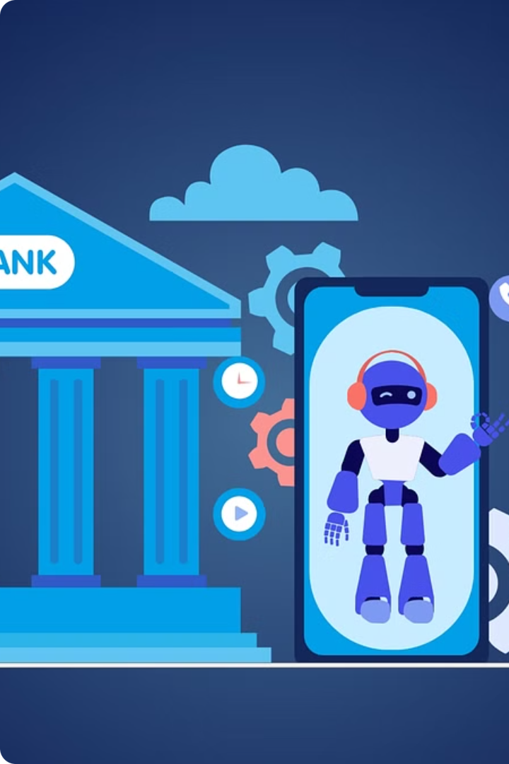
Unique Aspects of the Proposed Financial Advisory Chatbot Idea
The proposed financial advisory chatbot offers several unique aspects that set it apart. It provides highly personalized guidance based on individual financial data, goals, and risk tolerance. The comprehensive coverage addresses budgeting, saving, debt management, diverse investment strategies, and even the FIRE (Financial Independence, Retire Early) strategy, all within a single platform.
The chatbot's focus on the FIRE strategy is particularly noteworthy, offering specialized planning and advice for users aiming to achieve financial independence and early retirement. Additionally, the solution utilizes machine learning to continually optimize the accuracy and relevance of its advice based on user interactions, ensuring a data-driven approach to financial guidance.

Slide 10

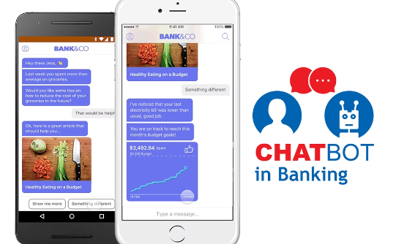

Enhancing the User Experience
Personalized Recommendations
Accessible Anytime, Anywhere
Educational Insights
The financial advisory chatbot is available 24/7 via web and mobile platforms, allowing users to access personalized guidance and support whenever and wherever they need it.
The chatbot provides valuable insights into financial concepts and investment strategies, empowering users with the knowledge they need to make informed decisions about their money.
The chatbot tailors financial advice based on individual financial data and goals, providing a truly personalized experience to help users achieve their unique financial objectives.

Slide 11




Scaling Measures for the Solution
Cloud Infrastructure
Load Balancing
Horizontal Scaling
Database Optimization
Utilizing scalable cloud services (e.g. Azure) allows for flexible resource allocation based on demand, ensuring the solution can accommodate growth without compromising performance.
Implementing load balancing techniques ensures even distribution of user requests across servers, maintaining responsiveness as the user base expands.
Adding more server instances or containers enables handling increased user traffic without degradation in performance, allowing the solution to scale effectively.
Employing database sharding or replication techniques ensures efficient data retrieval and management as user numbers grow, supporting the solution's scalability.

Slide 12
Simple Implementation and Maintenance
1
Modular Development
2
Cloud Deployment
Built with modular components, facilitating easier development, testing, and integration of new features.
Utilizes scalable cloud infrastructure for simplified deployment, scalability, and ongoing management.
3
Automation Tools
4
User-Friendly Interface
Incorporates automation for deployment, monitoring, and updates, reducing manual intervention and operational complexity.
Designed with an intuitive user interface (UI) to ensure ease of use, minimizing the need for extensive user training or support.

Slide 13
Security and Integrity Measures
Encryption
Authentication and Authorization
Utilizes strong encryption protocols (e.g., TLS) to secure data transmission between users and the chatbot platform, preventing unauthorized access.
Implements robust user authentication mechanisms (e.g., OAuth, JWT) to verify user identities and control access to sensitive information.
Data Privacy
Security Audits
Adheres to data protection regulations (e.g., GDPR, CCPA) to safeguard user data, ensuring it is collected, stored, and processed securely and ethically.
Conducts regular security audits and vulnerability assessments to identify and mitigate potential security risks and threats proactively.

Slide 14

Conclusion
We hope you've found our innovative Financial Advisory Chatbot solution to be a compelling and valuable proposition. This cutting-edge technology has the power to transform the way your customers engage with financial services, providing personalized guidance and support whenever they need it. As we've demonstrated, our chatbot offers unparalleled scalability, security, and user-friendliness, making it the ideal choice to future-proof your business. We appreciate your time and attention, and we look forward to the opportunity to collaborate and bring this transformative solution to life.
-Maddala Chatianya

